Slide 1

Creating a Pivot Table in Power BI
GROUP MEMBERS:
DHRUVI PATEL [400681265]
DIGESH KANSARA [400237016]
SUBMITTED TO :
Prof. Nanda ganesan

Slide 2
Table of Contents
Objectives
Introduction
Literature Survey
Detail explanation of Pivot table in Power BI
Dashboard of Covid- 19
Discussion
Conclusion
Web References
Q&A

Slide 3
Objectives
Many of you might have heard creating a pivot table in excel. This presentation will guide us along with creating and formatting the pivot table in Power BI.
The product Power BI is well marketed and has a clear role to play. There are many stuffs in excel but this product would be great doing all those stuffs with ease and thus this enhances the knowledge on the new product called Power BI.

Slide 4
Introduction
In this Presentation we will be demonstrating a powerful tool called as pivot table in Power BI, this explains how to create pivot table in Power BI using the following dataset. In this will have a look on the process of creating a Pivot Table in Power BI in 4 steps:
How to Create a Pivot Table in Power BI
How to format your (Power BI) Pivot Table – Similar to Excel
Slicing and Dicing Data
New Features in Power BI Pivot Tables that weren’t there in Excel

Slide 5
Literature Survey
Microsoft has faced with its “new” suite of self service BI Tools [particularly pivot table] is that most people that could benefit from several other tools.
With addition to Power BI , there are different Business intelligence solutions like Power Pivot , Power Query including Power BI.

Slide 6
Step 1: How to create a pivot table in Power BI.
Firstly there is no “Pivot Table” in Power BI but there is a “Matrix Visualization” which is almost equivalent to a Pivot Table in Excel. It offers nearly the same features as Pivot does In Excel but they are named differently and of course placed differently.
In this example, the spreadsheet contains the information of the salesperson, the product sold by the salesperson, the region in which the product was sold and the customer who bought the product, date, the item cost, No. of items sold of each of the product sold and the total cost.

Slide 7
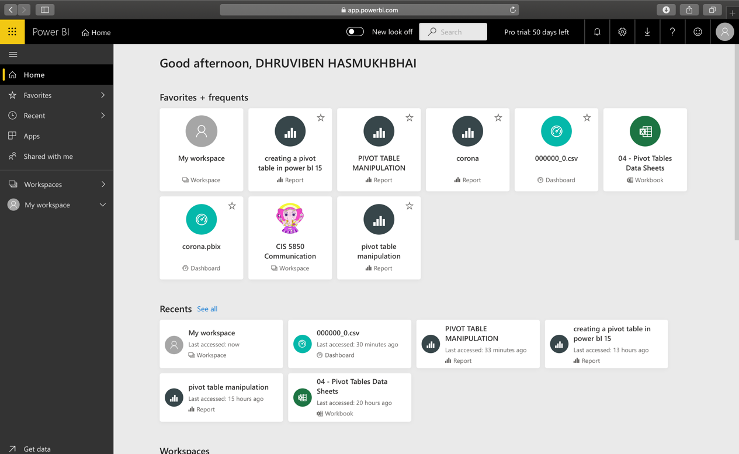
Power BI window:

Slide 8
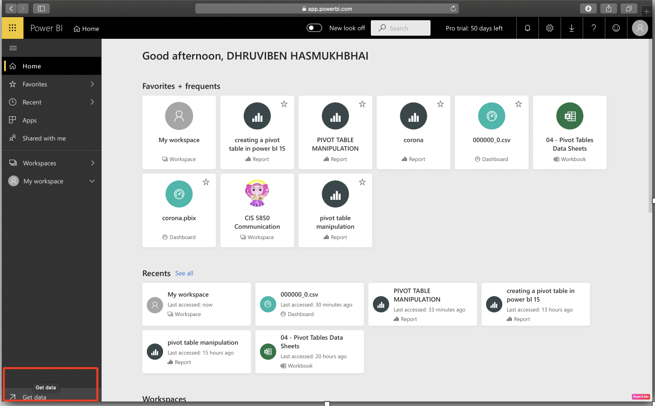
The next step is to get the data imported into the Power BI, for that on the left bottom there is a Get Data button simply click on it.

Slide 9
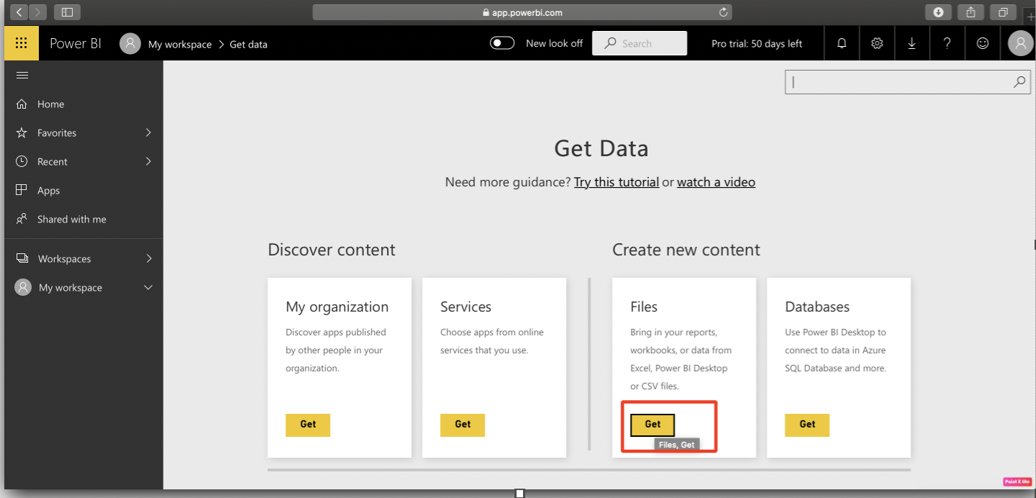
Once you click on get data , it will redirect you to the window wherein you can select the files by clicking on Get button.

Slide 10
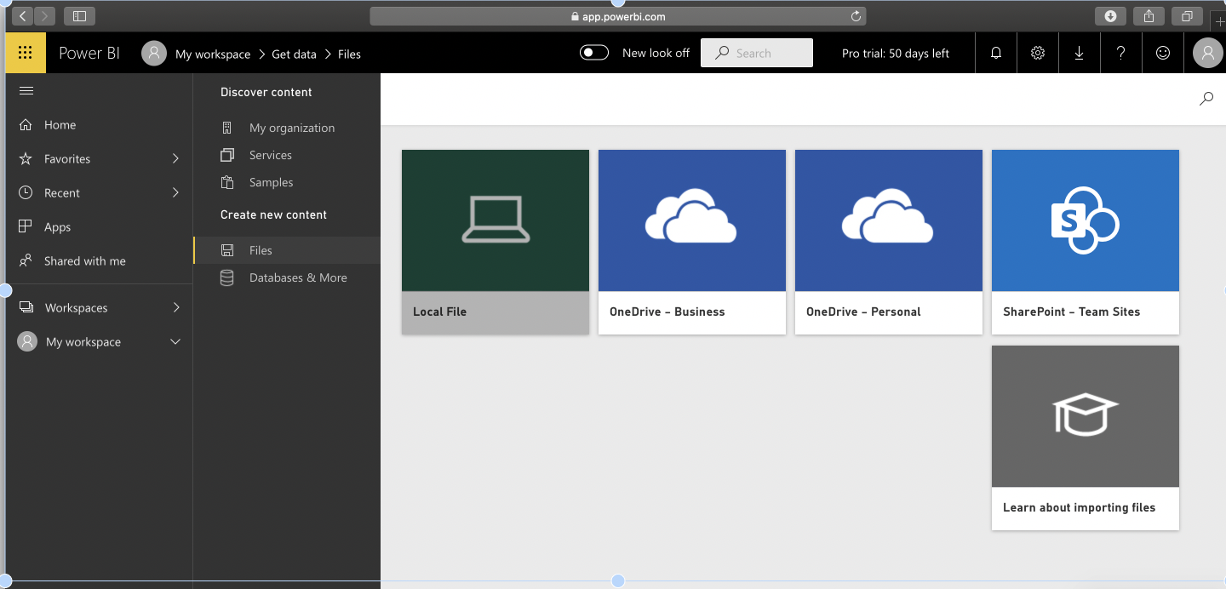
The next step is the system will ask to get the path that you can select to upload the files. In this you need to click on local file .

Slide 11
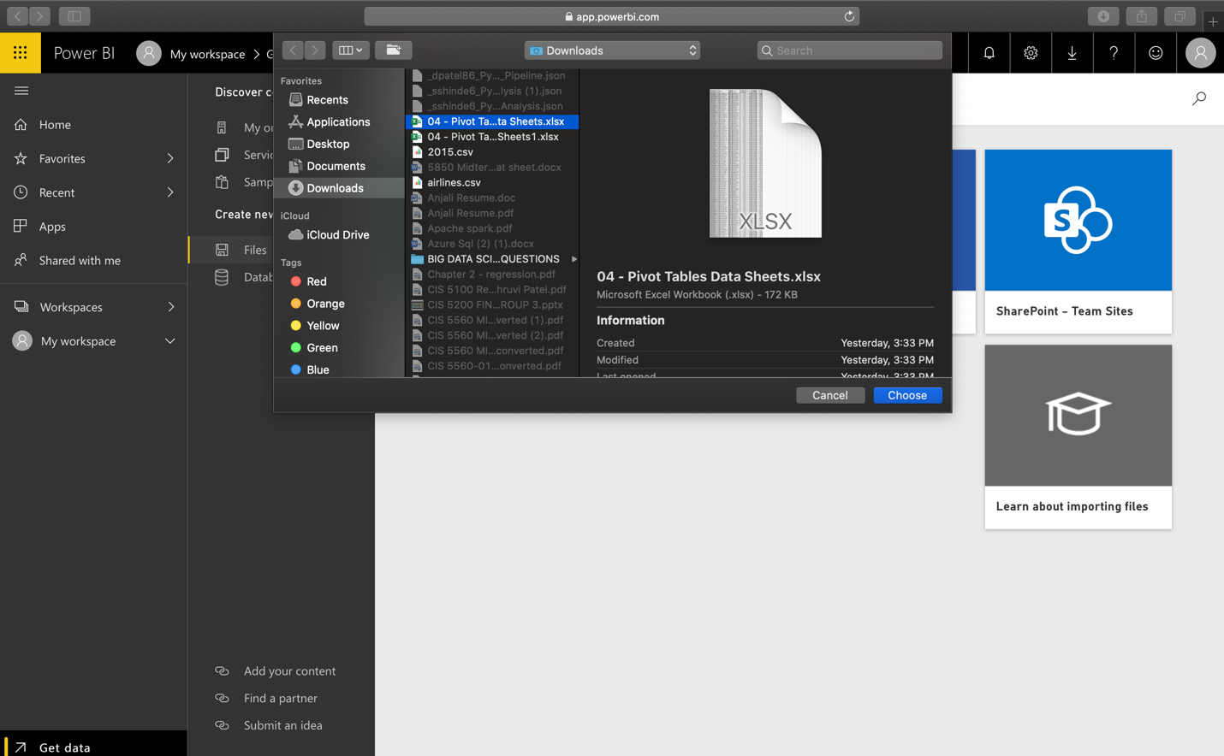
Once you click on local file , upload the dataset file to the system and click choose.

Slide 12
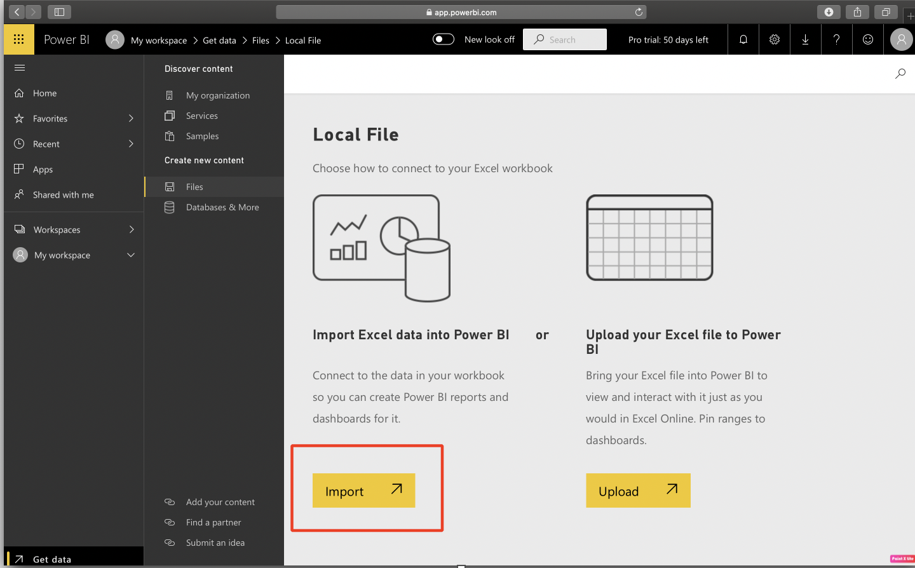
Once you click on choose it will ask you whether you want to upload the files or import the files to the Power BI.

Slide 13
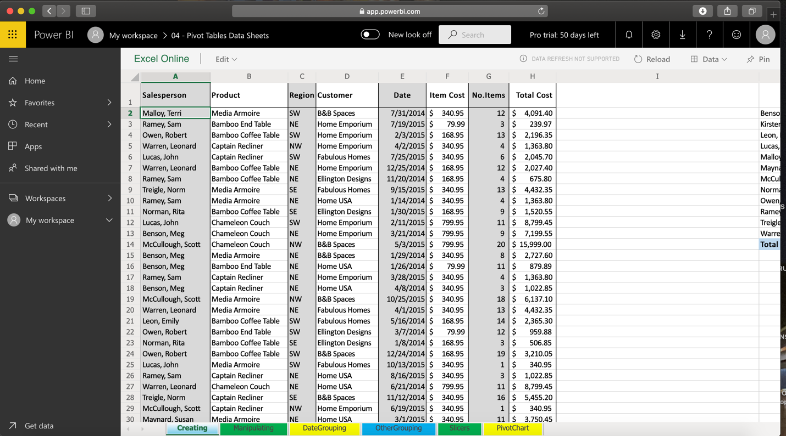
Thus upon selecting the import button it will import the file to the Power BI. So this is how it looks. This is the data set that has been imported to the Power BI.

Slide 14
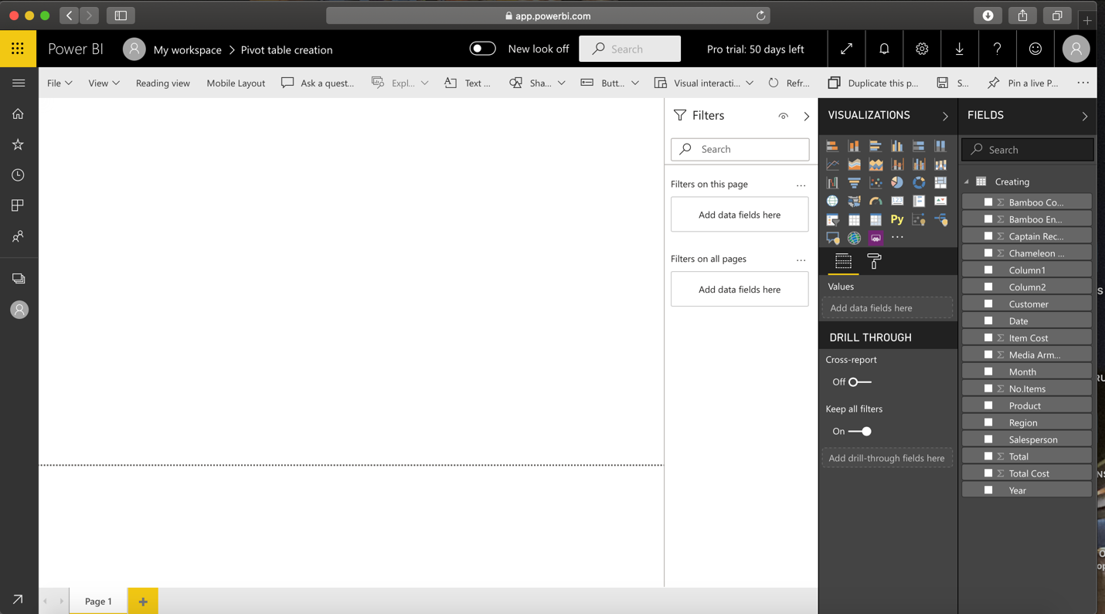
The following image shows the workspace area wherein a Pivot table Can be created

Slide 15
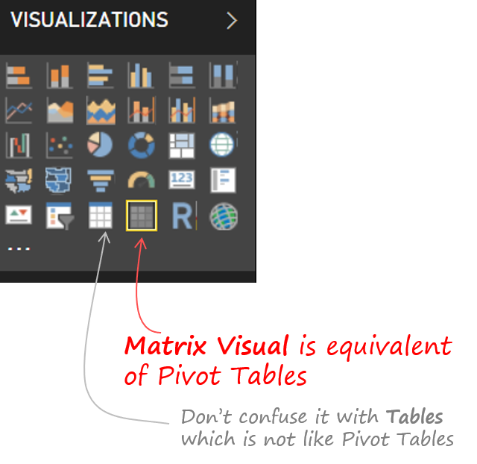
To create a Pivot , Pick up the “ Matrix Visual” and NOT the Table Visual.

Slide 16
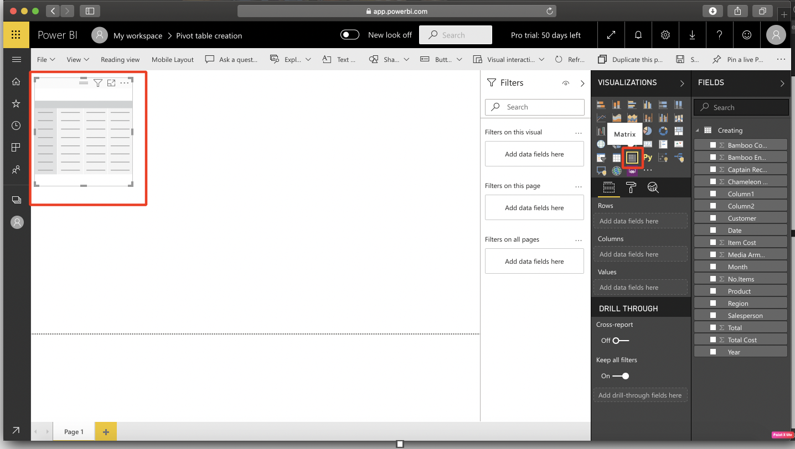
If you click on Matrix it will be seen on the screen, then drag one of the corner of the matrix to look bigger in size.

Slide 17
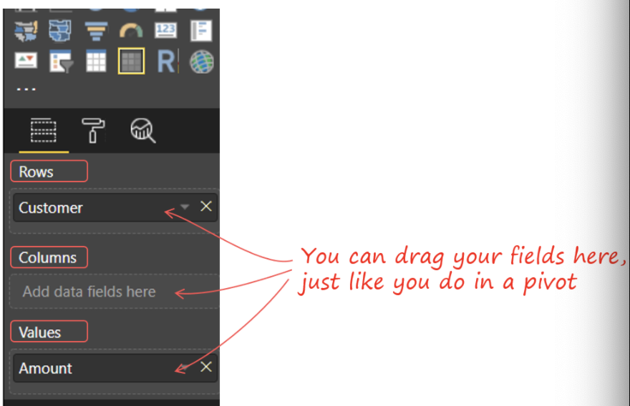
As soon as Matrix is created, you will get similar options like you do in excel that is you will be able to see Rows, columns and values. To insert the values into rows, columns you just need to drag your fields here the same way as you do it in a pivot.

Slide 18
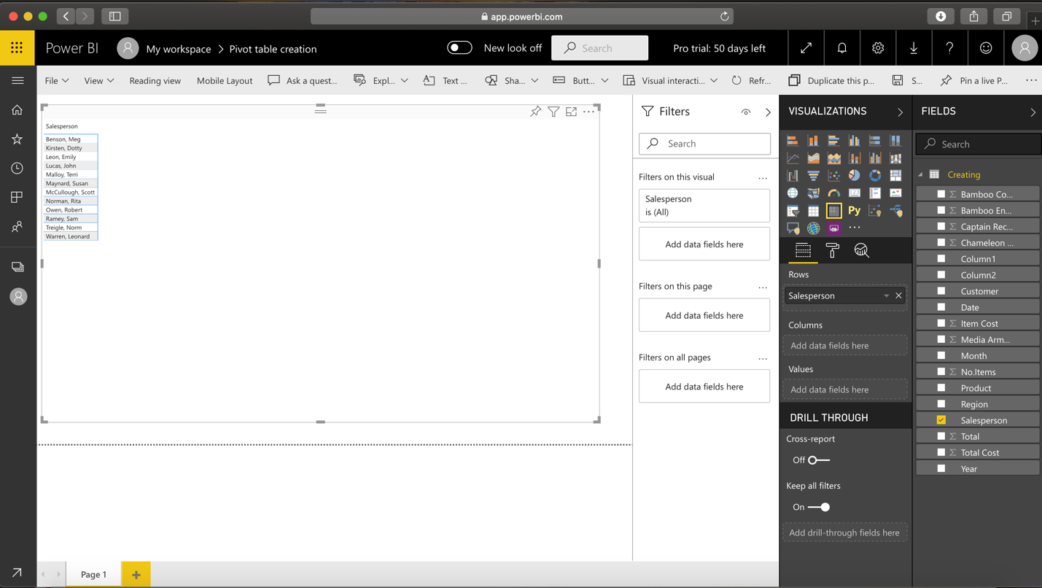
Now you will start creating the pivot table of the following dataset that you have imported using the fields and dragging and dropping them to the relevant rows and columns. Now Click on Salesperson, to create the row as salesperson you can either the select the box next to salesperson or simply drag and drop the salesperson field into the area. Now you will be able to see that salesperson is added into the matrix area.

Slide 19
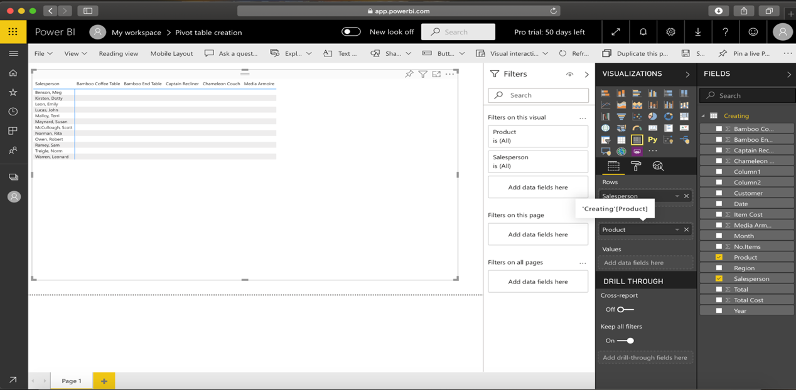
The next step is to drag the item that must be displayed on the column, in this case we will display the product into the column, For that click on Product and the drag into the columns box. No you can see that the column heading are defined by the product name that is bamboo coffee table and so on.

Slide 20
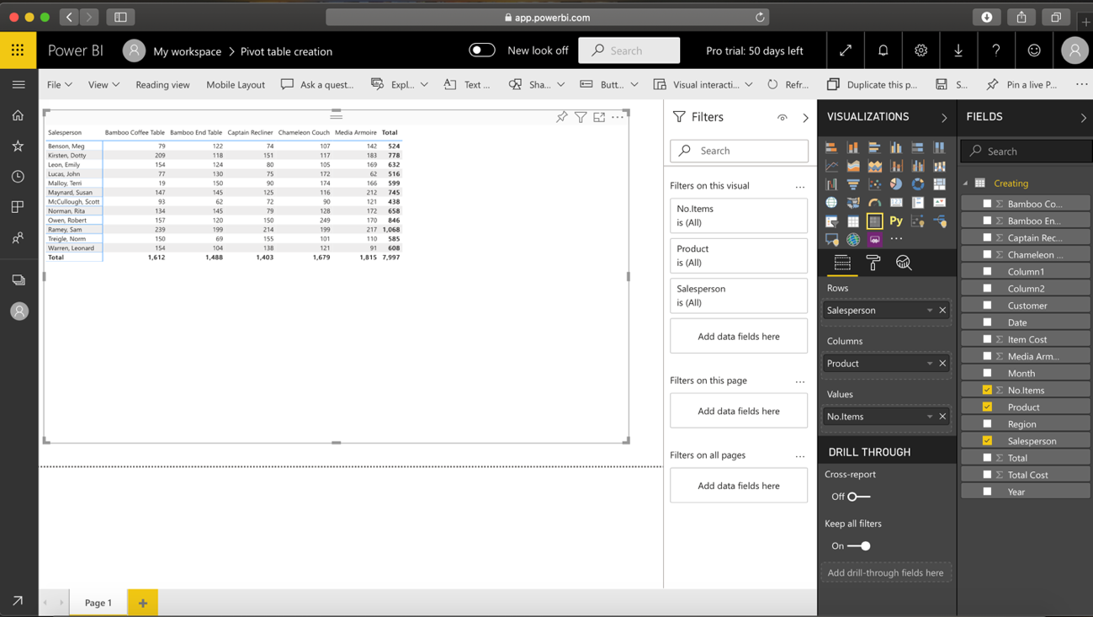
The next thing is to display the count In each of the cells , that is we need to display the number of bamboo coffee table sold by the salesperson Benson Meg. To do that , look for no. of items and drag it and place in values box. Select the No.of item checkbox and drag it to the values section. Now you can see that we have inserted all the fields and this is how the pivot table looks like.

Slide 21
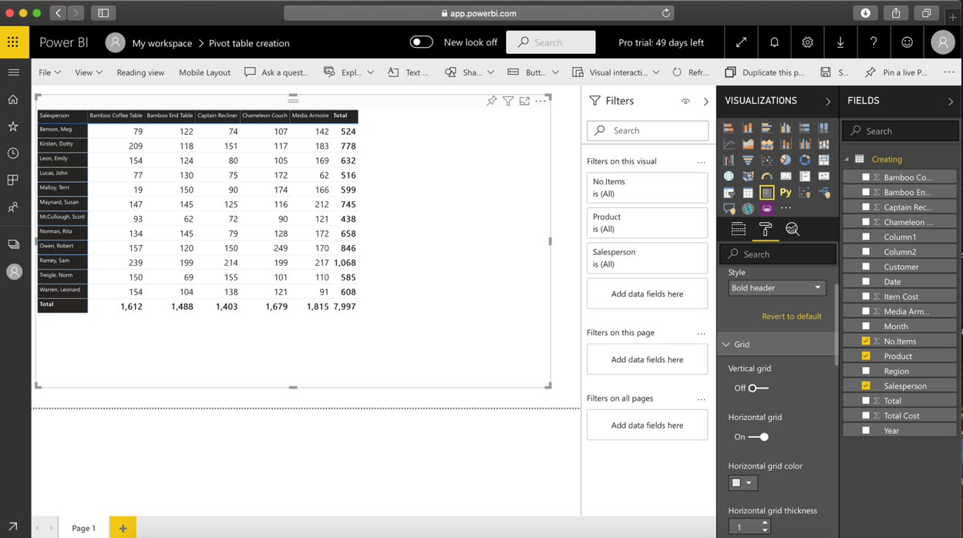
You can change the style of the table by going to visualizations and then under style select Values and then under style select the style .

Slide 22
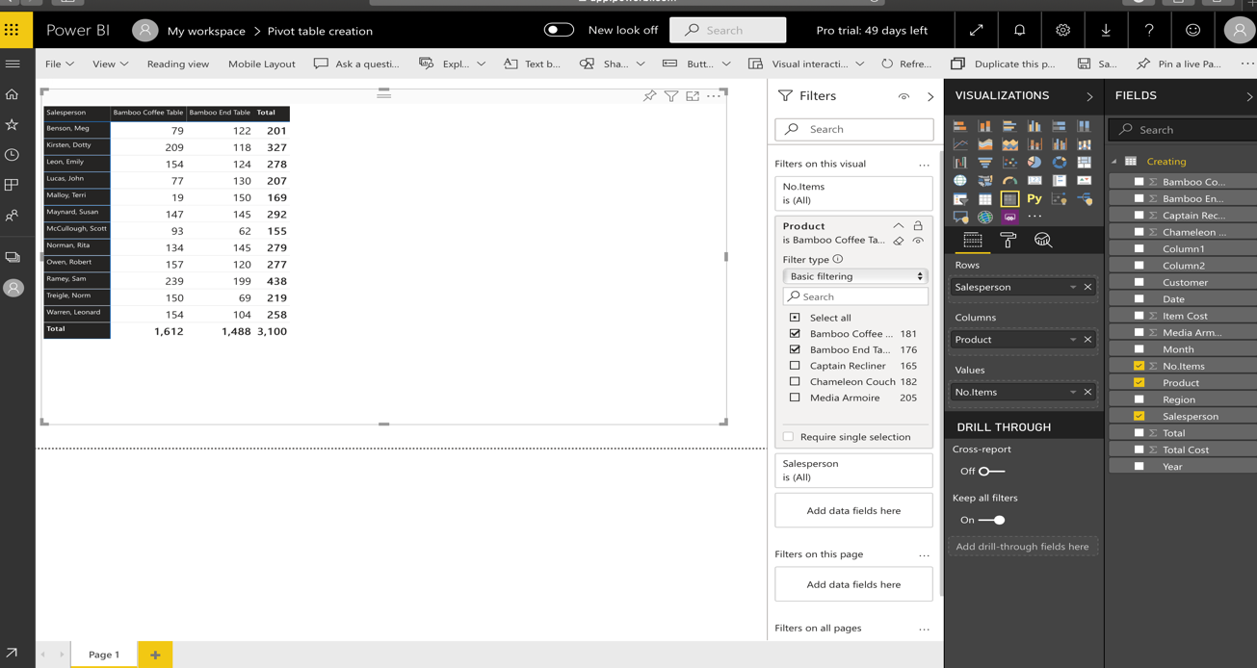
Now in order to apply the filters you can also do that since the option for filter is available, you can do so by checking and unchecking the checkboxes that are available there. For example if we want to display only two items like Bamboo coffee Table and Bamboo End table then check the checkbox of that and that two products will be only displayed. Thus you can see that in the output.

Slide 23
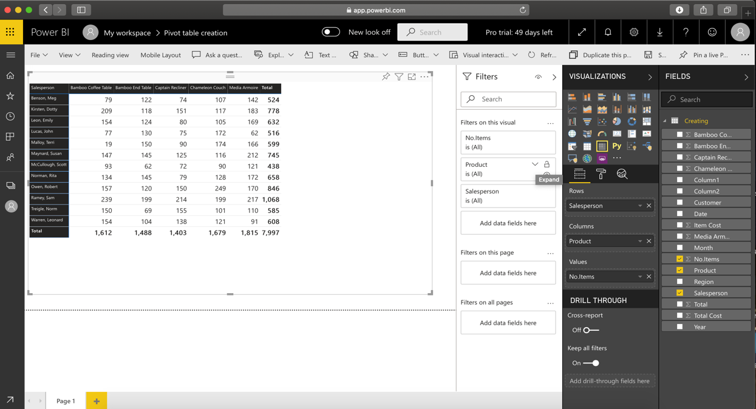
The filter option in pivot table also provides us other option to display the data. For example you can also display the item that start with C. This can be done as follows:
Firstly expand the Product filter option.

Slide 24
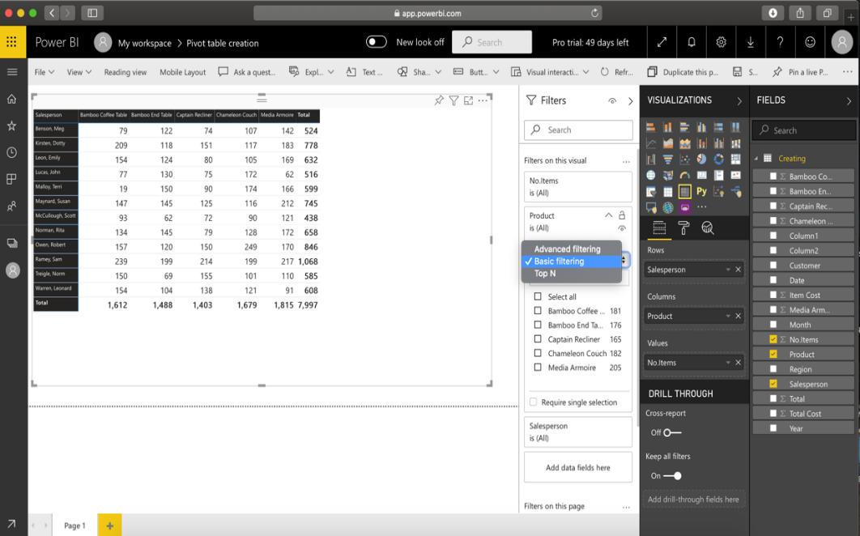
In the filter type initially it is selected as Basic Filtering, change to advanced filtering.

Slide 25
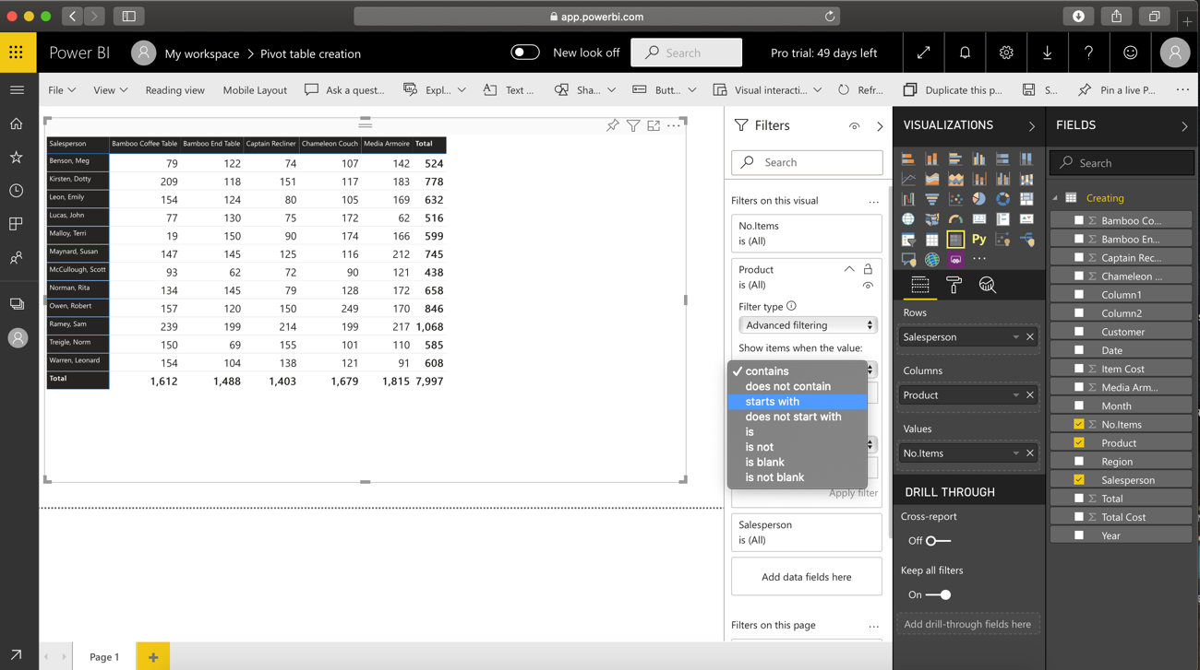
Under the “show items when the value”, we want to display the item to start with C, for that we need to select starts with from the drop down menu and write “C”.

Slide 26
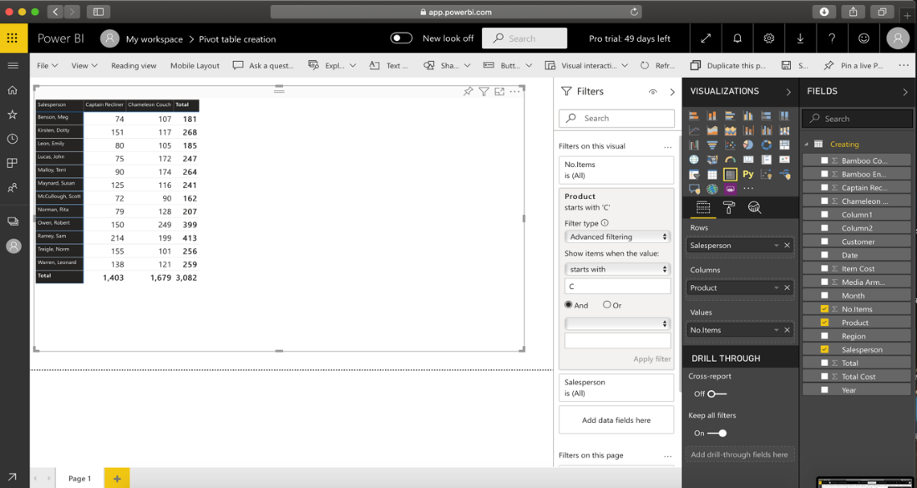
After this is done, click on Apply Filter. The Output will consists of the item name that start with C.

Slide 27
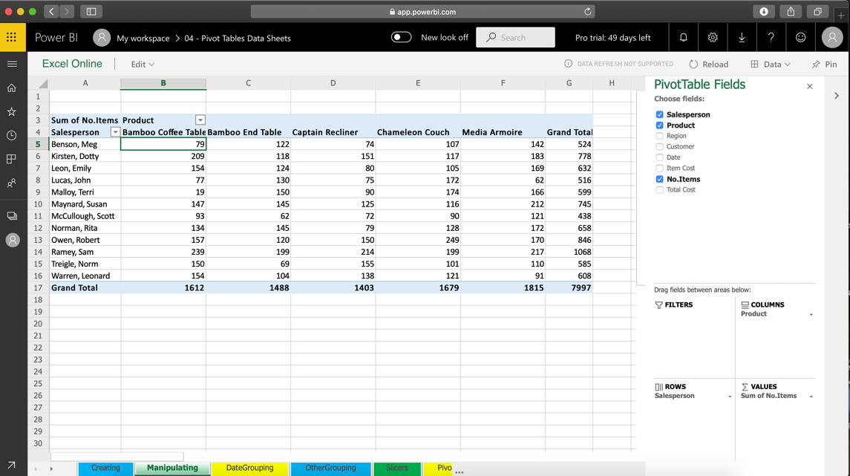
MANIPULATING A PIVOT TABLE
In this example we will show the manipulation of the pivot table that is shown earlier.
The pivot table is found in this manipulating tab.

Slide 28
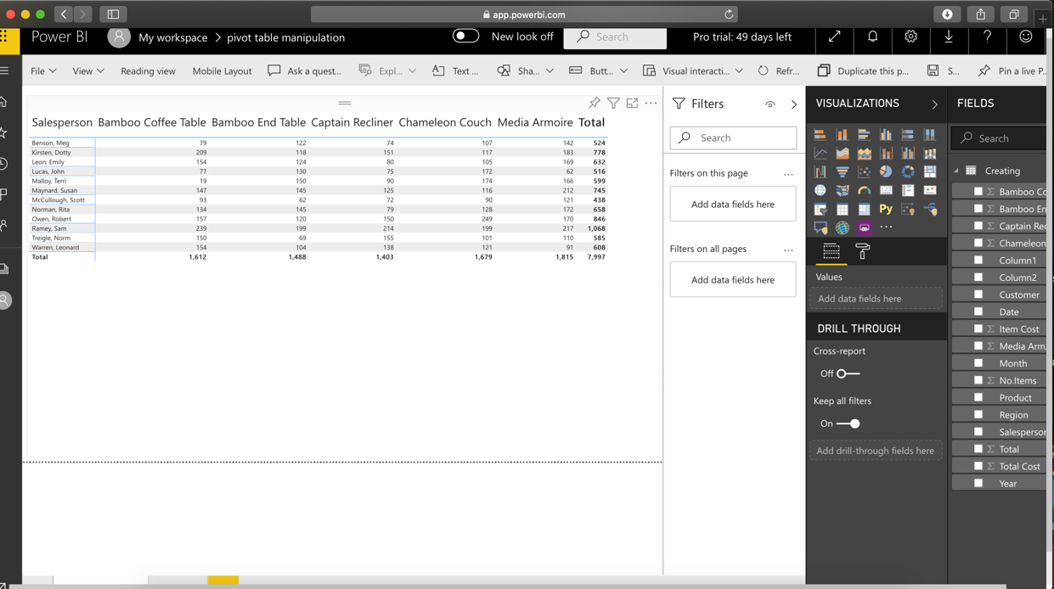
At this point of time the pivot table relates the salesperson to product , we want to change the display to customer and salesperson.
Table 1: Display relates Salesperson and Product

Slide 29
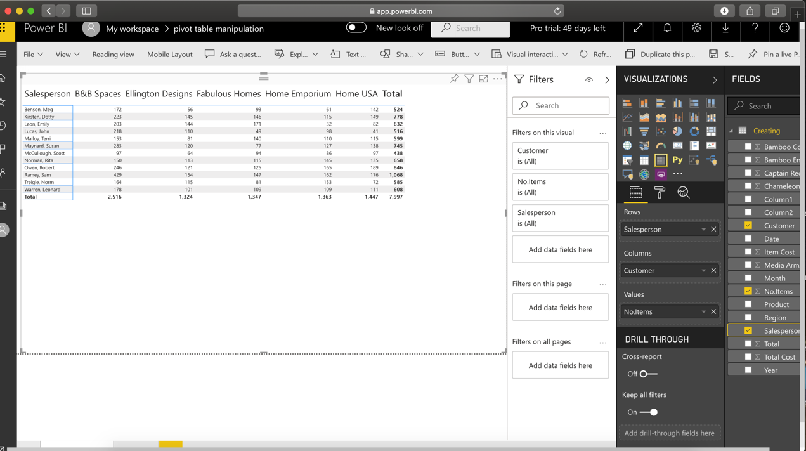
To change the display to customer and salesperson, this can be done by changing the fields that are in the column and the fields that are in the rows.
Table 2: Table showing Display customer and salesperson

Slide 30
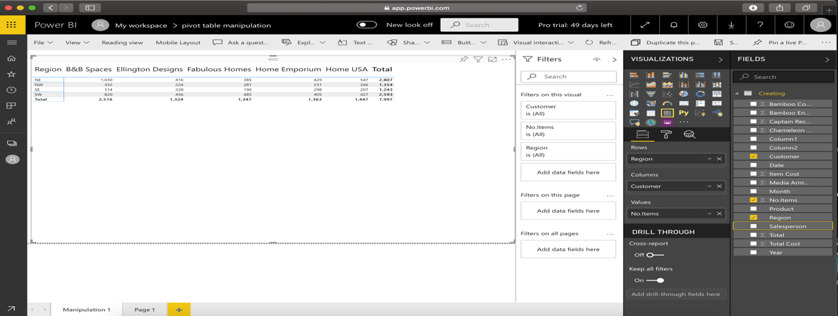
Now you will change the table to display customer and region , at this point we are displaying customer and salesperson , in order to display customer and region , this can be done by changing the fields of Rows to region and rest everything else stays the same.
Table 3: Table showing Display Customer and Region

Slide 31
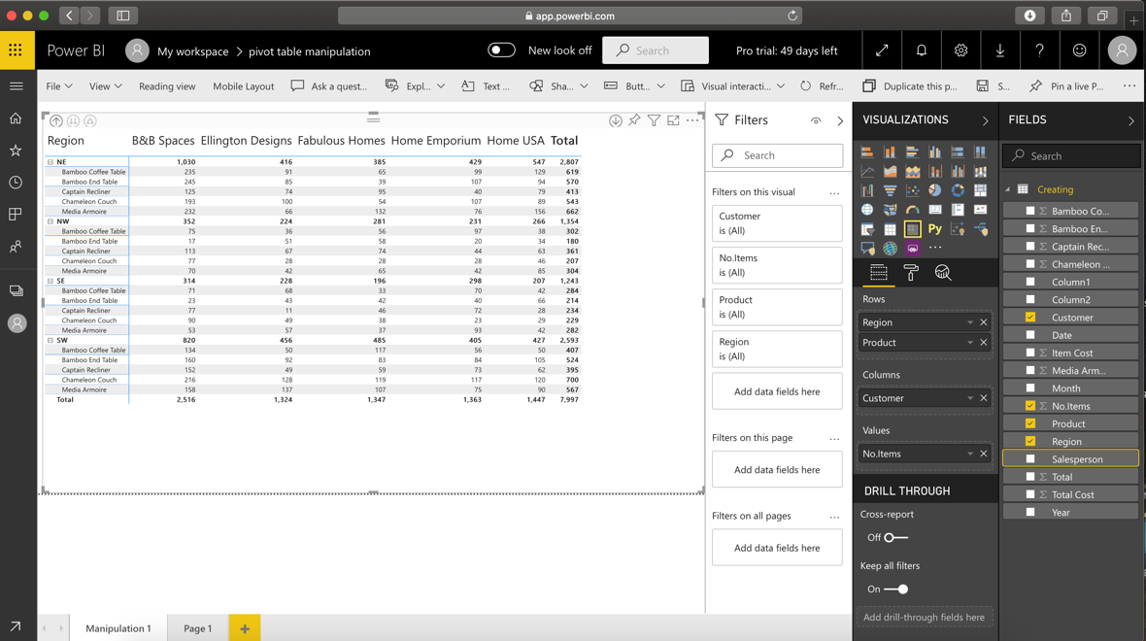
In the next example we want to display two fields in a row, there will be three fields in the table
Table 4: Table showing Display to Customer , Product and Region

Slide 32
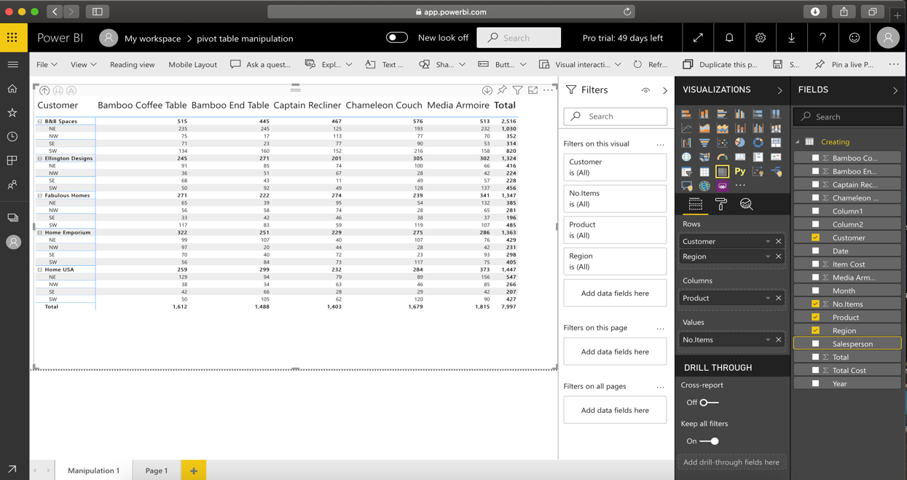
you can also reorder the fields such as place the customer in the row box and drag and put the product in the column box, you can see the order of display has changed. The table divides the customer into regions and products that are sold.

Slide 33
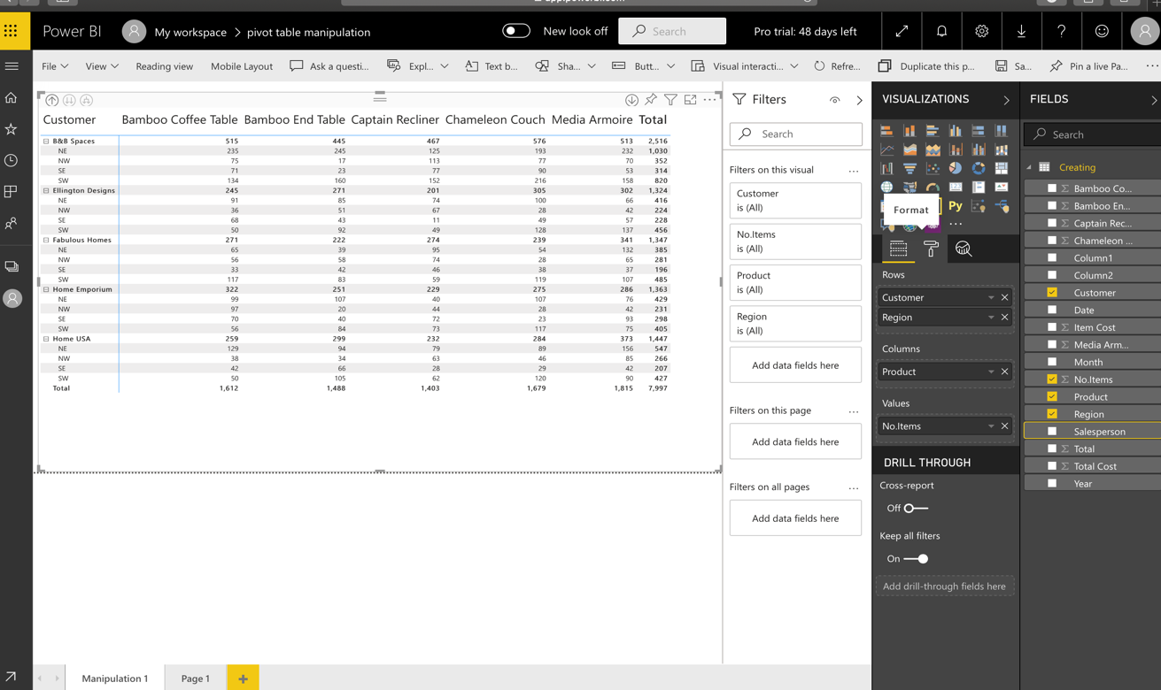
Now if we don’t want to see the subtotals or in other words hide the subtotals there is a way to hide that and that is done as follows : 1. click on the format button first and from there it gives the option of subtotals.

Slide 34
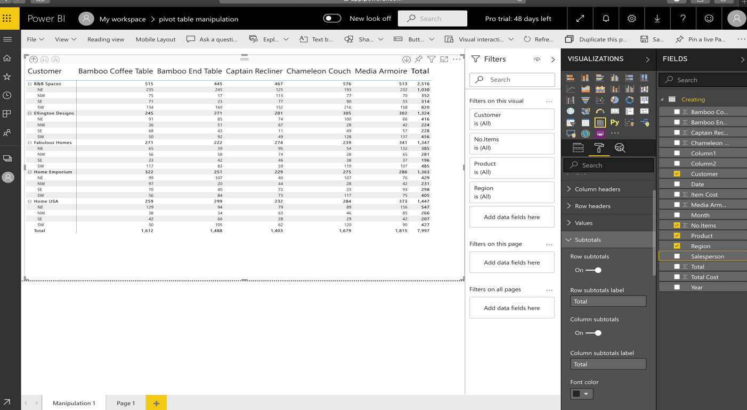
2. In that there would be an option of subtotals , expand that option .

Slide 35
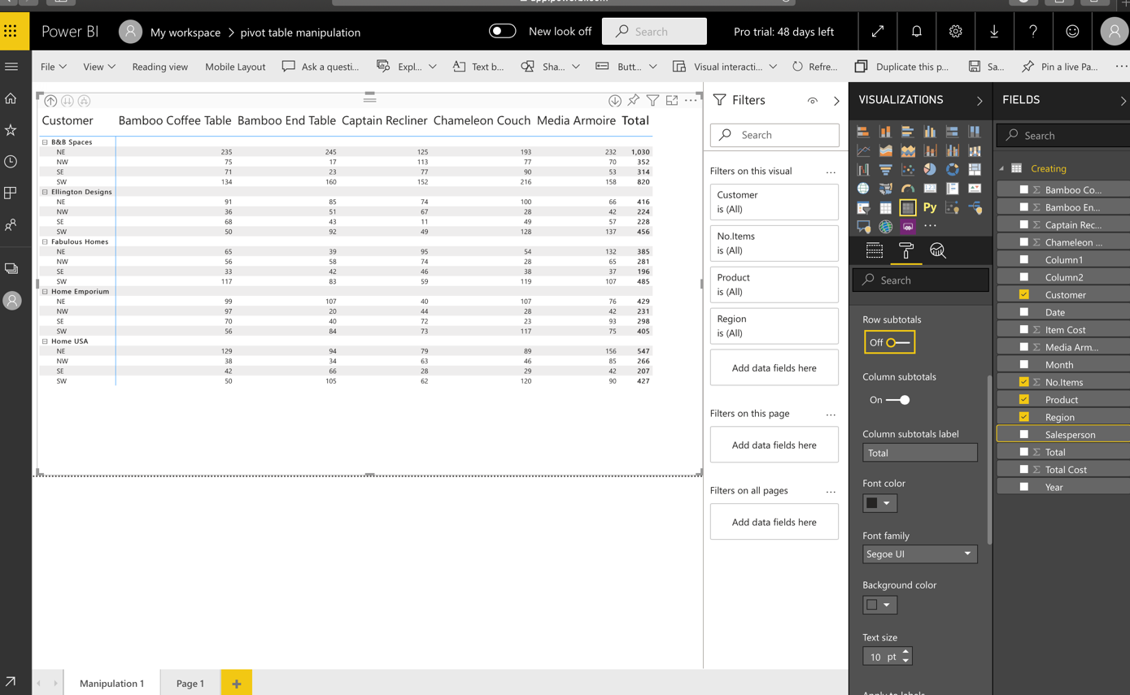
3. Now you can see that the row subtotal is on , click on the slider and turn it off, once It is turned off the subtotals will not be shown.

Slide 36
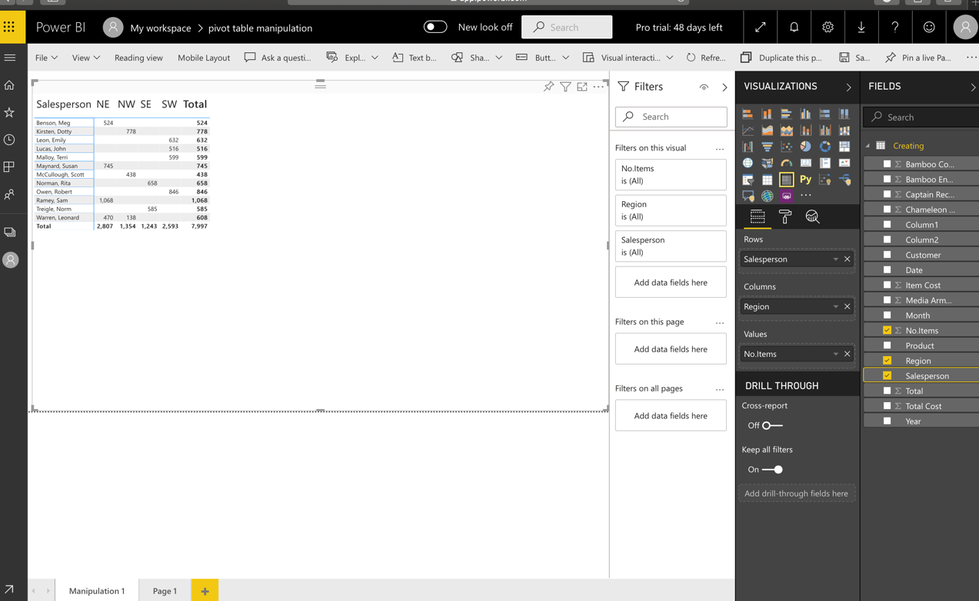
READABILITY ISSUES: Sometimes there is a better way to recreate the table that is as shown, that is the display is not good in that case we need to interchange to make it good. In this example we will remove some fields and replace the fields with some another field. For that you will drag the field named Region and place it in column and drag salesperson and keep it in Rows and no. of item as value , therefore for analysis of data this factor of readability must be kept in mind for easy and proper understanding. This will let us analyze the data in easy and convenient form.

Slide 37
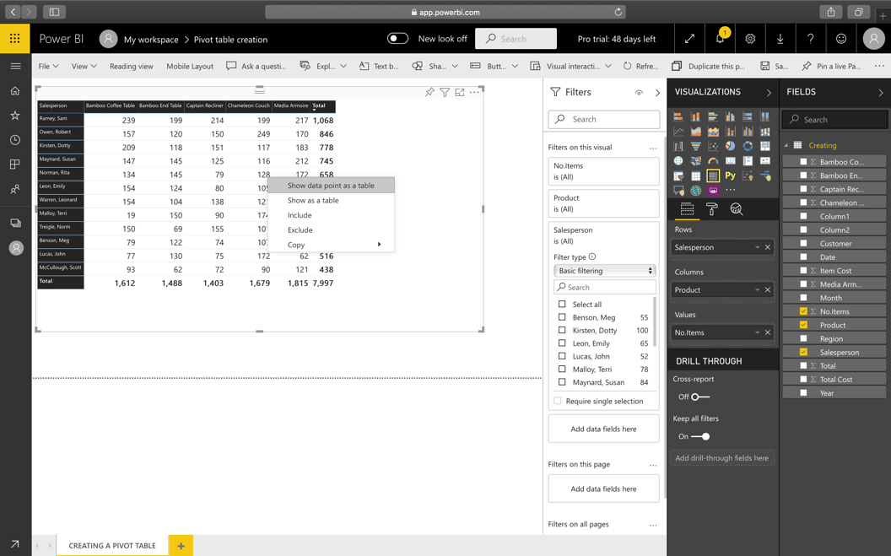
DRILL DOWN INTO DATA :
Drill down into data feature is extensively used in data analytics.
In this example we will be selecting an entry and we want to get an additional information about that particular entry that was selected , For example where 128 units have been sold by Norman, Rita to get an additional information of this units we will right click and click on show data as point , this will expand the table.

Slide 38
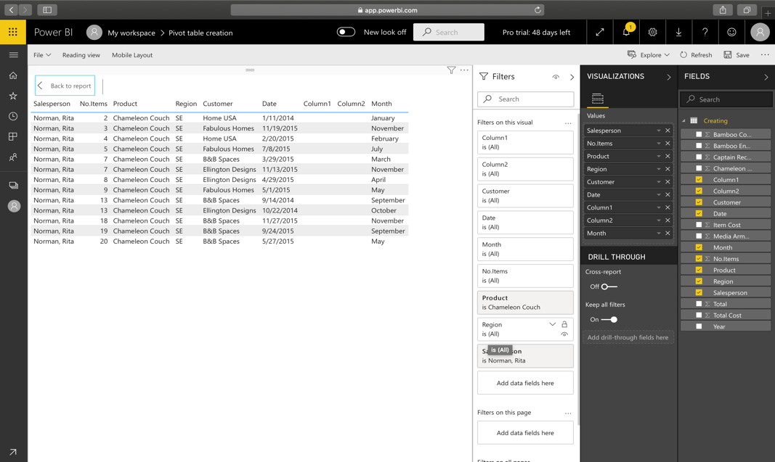

Slide 39
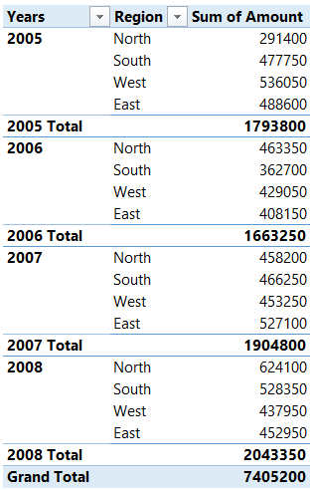
STEP 2: Formatting Features
2.1 Creating a Tabular/ Classic View:
Tabular/ Classic View allows each field in rows to occupy a separate column. Here is how a tabular view looks in a pivot table .
Years and region are placed in columns occupying different columns.

Slide 40
This can be done in Power BI in following ways:
After you create the Pivot and drag years and region in Rows, click on the double arrow icon to expand the Pivot
Then click on the “Format Tab” in the Visualizations Pane
Roll down to Row Headers
And turn off Stepped Layout

Slide 41

2.2 Adding and Removing subtotals
Click on the format tab once again.
Roll down to the subtotals and Grand total
There is an option of turning them on/off in the visualization pane. Expand the subtotal option and you will be able to see the option.

Slide 42
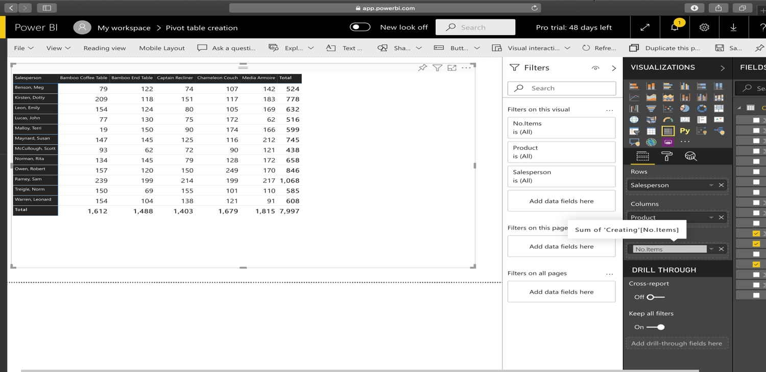
2.3 Renaming the Fields
Often to customize the report users would like to give the custom names to field headers. So in that case there is an option available to rename the field. Apparently Date field can not be renamed.
To rename the field just double click on the field which will activate the rename option. You can rename it .

Slide 43
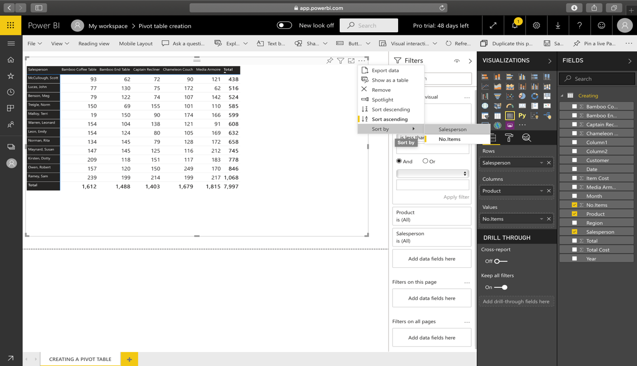
2.4 Sorting Data
Sorting in a Matrix is one the most intuitive tasks in Power BI. You need to click on the header to sort the data in ascending or descending order. For that :
Click on the three ellipse button [ that says more options ], it will ask you to sort by and then a arrow mark will appear on the field you select and them you can sort the data .

Slide 44
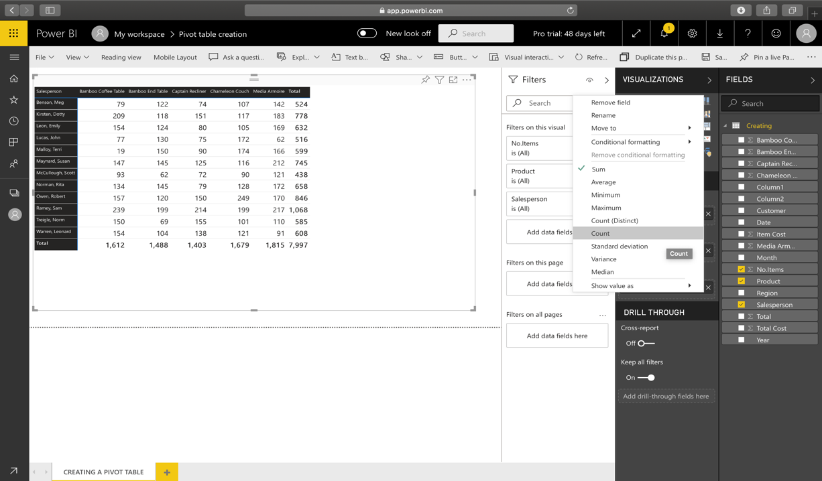
2.5 Summarize and show value as an Option
The summarize and show value feature is one of the important features that let’s you customize calculations in a Pivot Table. To avail that in Power BI here is what you need to do.
Click on the arrow against the field placed in the values
You can then pick up the summarize or show value as you like.
Also you’ll notice that there aren’t as many options especially for Show Value As, as compared to Pivot in Excel.

Slide 45
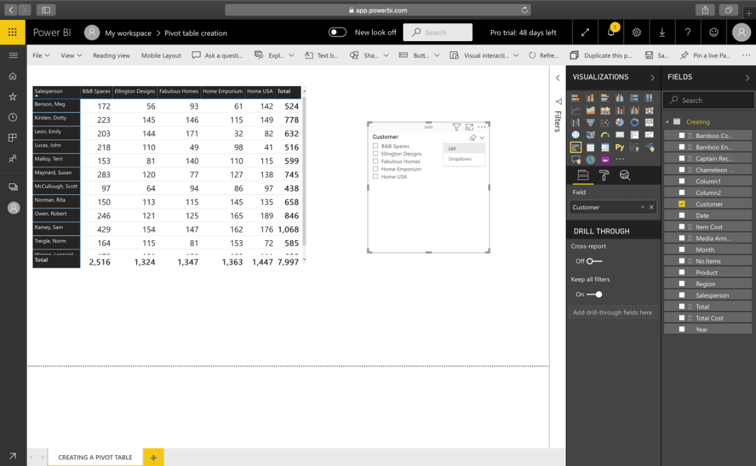
STEP 3: Slicing and Dicing Data in Pivot
3.1 Adding Slicers
There is a functionality of using slicer in Power BI.
Add the slicer visual and
Add the field that is column [ in this example I have added customer] to the slicer.
Slicer is very important feature to filter data.

Slide 46
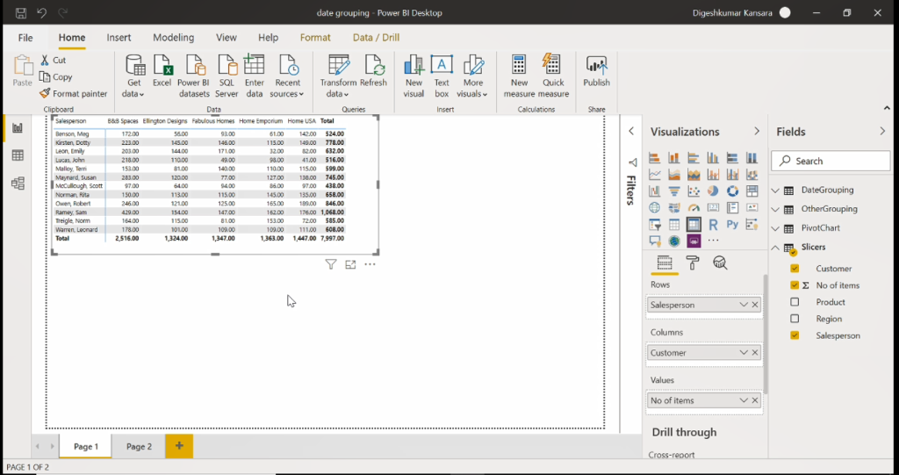
Create Matrix IN SLICER To demonstrate a slicer we need table which we can create by just clicking on matrix button. Rows: Salesperson Column: Customer Values: Number of Items

Slide 47
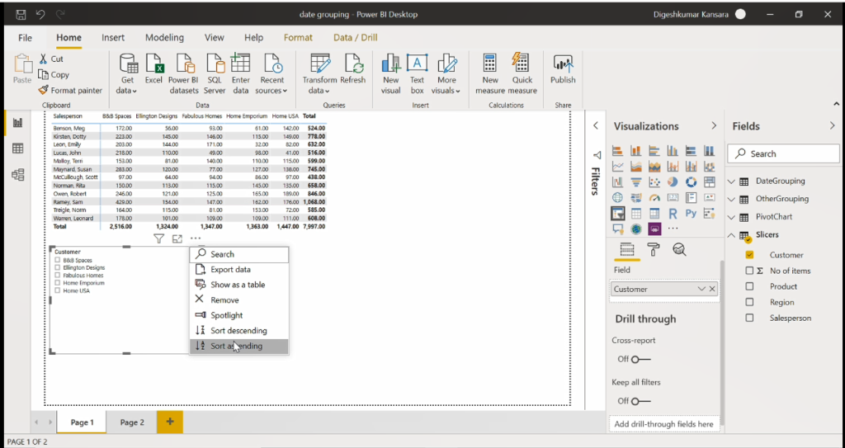
Sort Slicer To sort slicer click on option menu on top (3 dot button). We can sort them by Descending or Ascending.

Slide 48
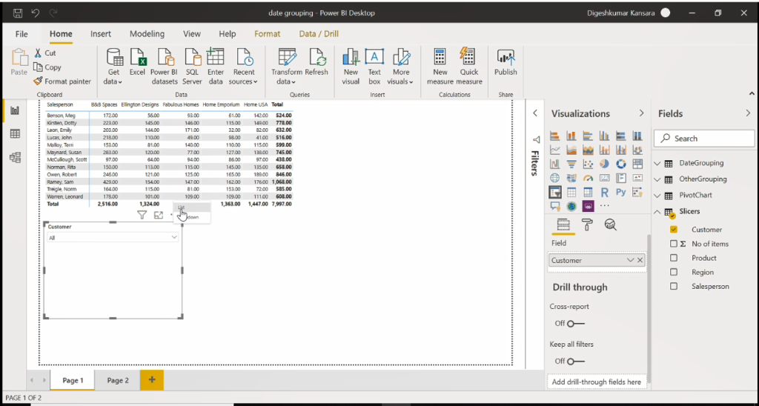
Drop Down Slicer To create drop down slicer click on reverse tringle button and then choose drop down. Drop Down slicer is normally used in dashboards.

Slide 49
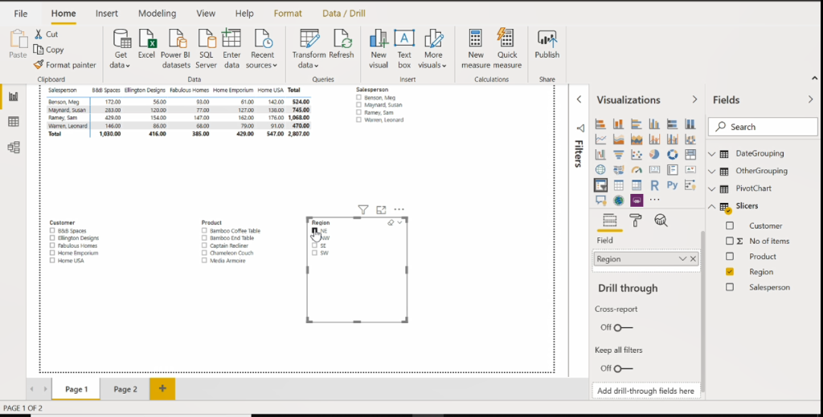
Slicer Demo To use slicers we can just click on filed. foe example I want to see NE data just need to check box NE. To select to filed (NE+SE) use control button and right click on it.

Slide 50
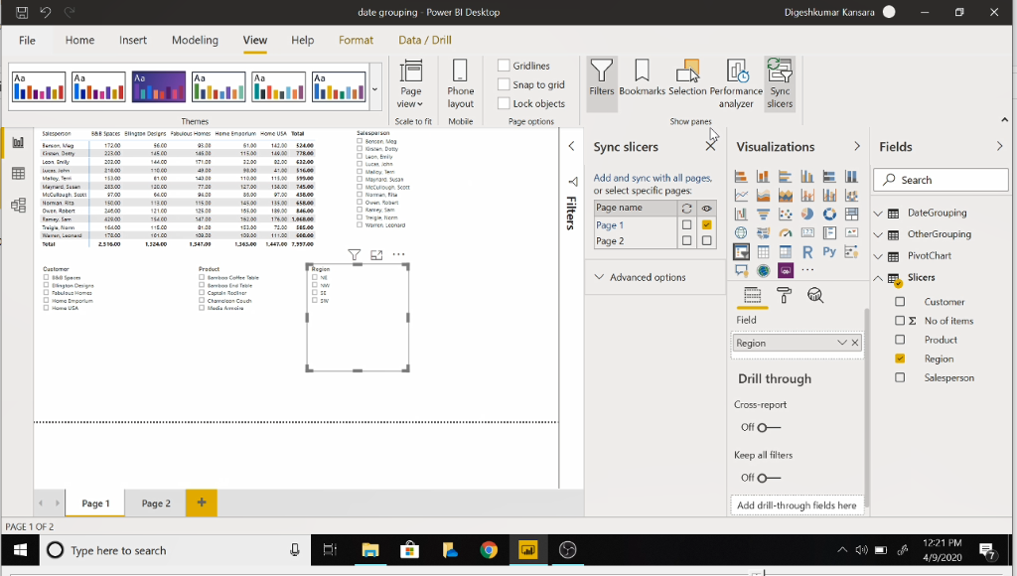
Sync Slicers sync feature is very important when we have multiple report in one dashboard. sync slicers means we can see same slicer on different report in same project. we can do it by [view→sync slicers ] and choose eye button.

Slide 51
dATE gROUPING IN A PIVOT TABLE
In this example we will show the date grouping feature in pivot table.
The pivot table is found in this Date Grouping tab.

Slide 52
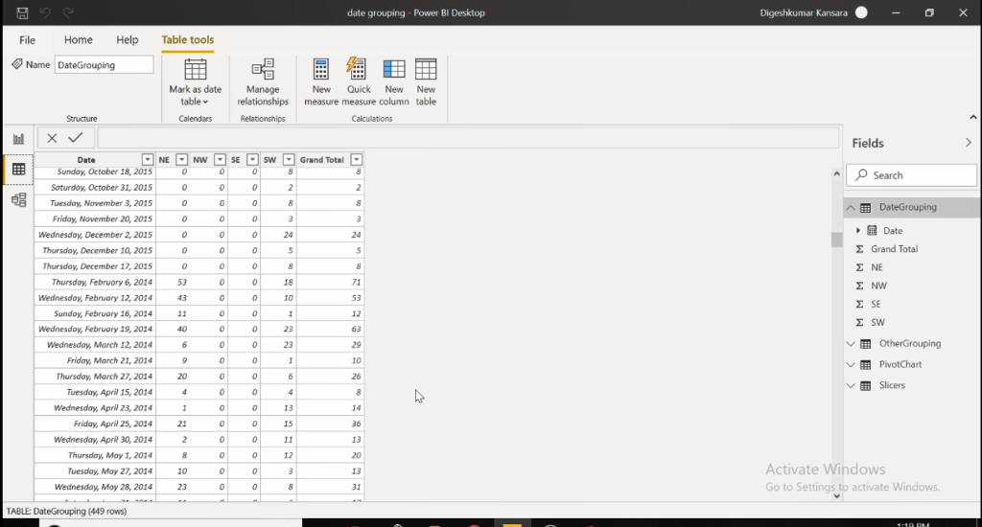
Data Exploration In this datasheet data organized by sale in particular region on particular day

Slide 53
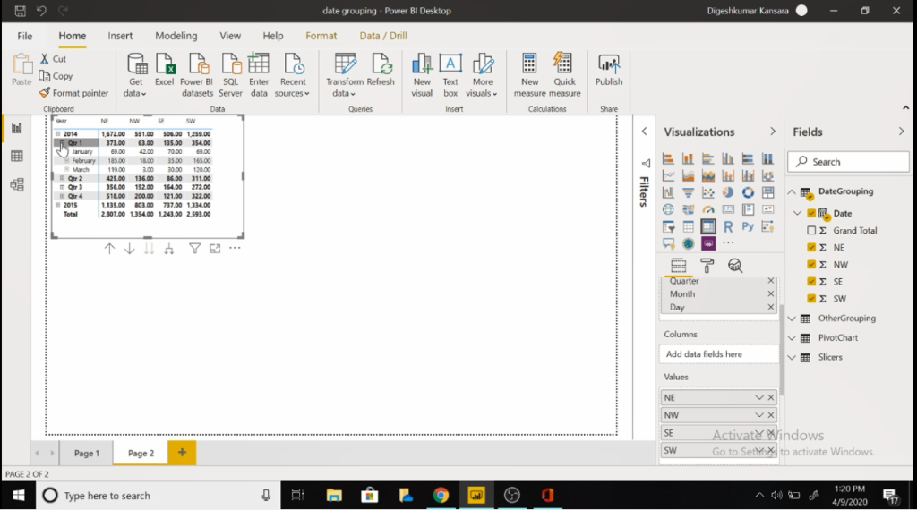
Create matrix table and analyze it we already see how to create matrix in previous slides. Row: Date Value:NE,NW,SE,SW We can click on Small plus button to extend the hierarchy. Year → Quarter→Month→Day

Slide 54
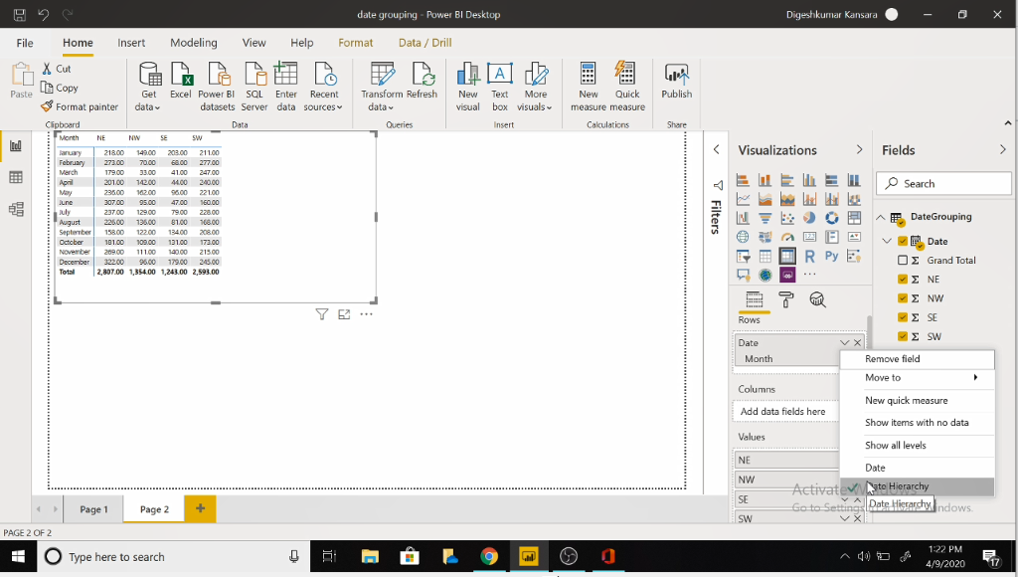
Show data by only month and bring hierarchy back To see data by month we can remove year and quarter by clicking on small cross button. We can bring hierarchy back from clicking on Date hierarchy.

Slide 55
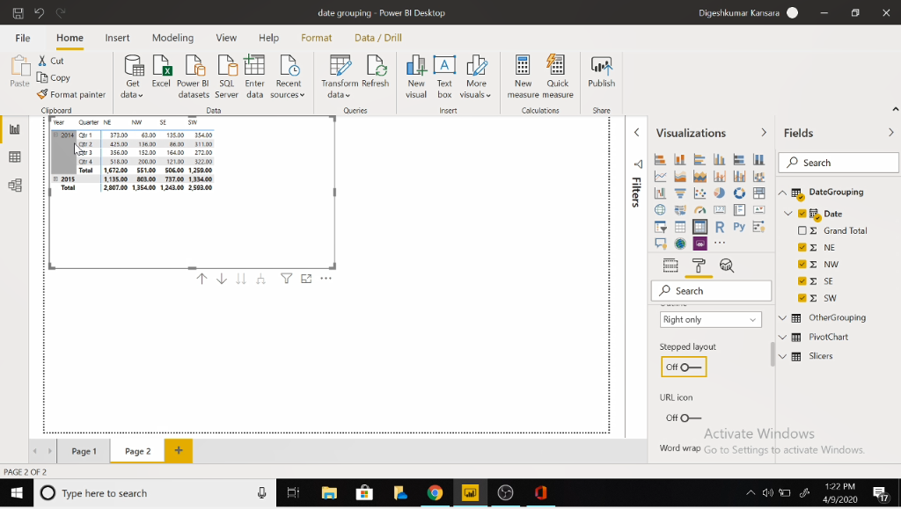
Make different column for quarter and month when we expand hierarchy want two separate column for year and quarter. Go to format tab and turn on stepped layout.

Slide 56
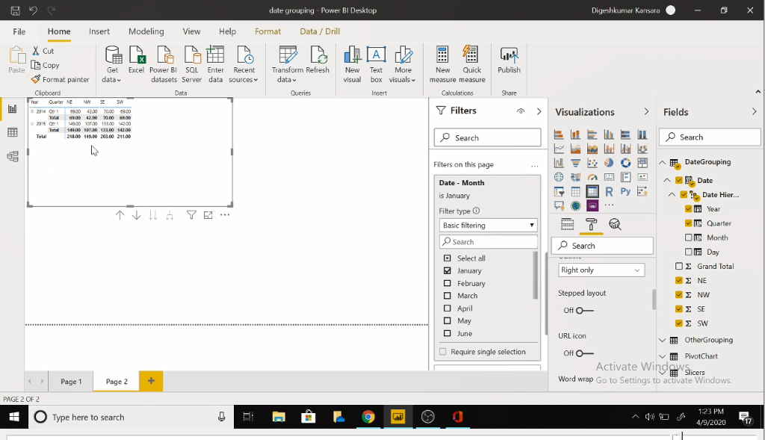
Filter by different month like excel we can filter data. there are three type of filters on chart level ,page level and report level. for example we want to just analyze January month data.

Slide 57
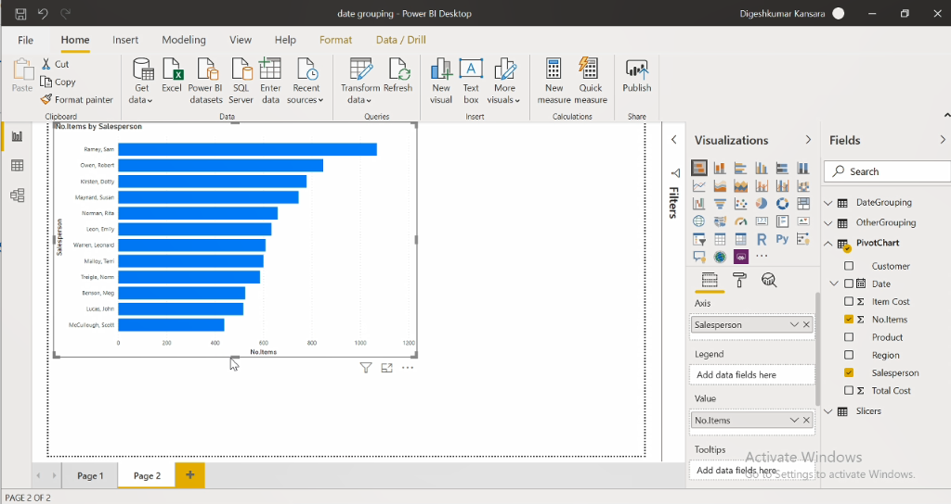
Pivot Chart stacked bar chart excellent way to visualize data is by creating different chart. power bi contains many visualizations than excel. axis: sales person value: no items

Slide 58
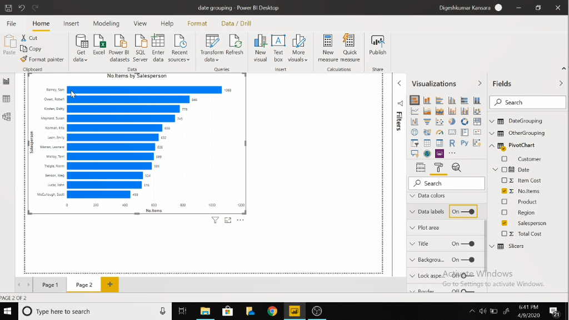
Format Charts another good thing is that we can format chart by giving them labels , change title size colors and too many.

Slide 59
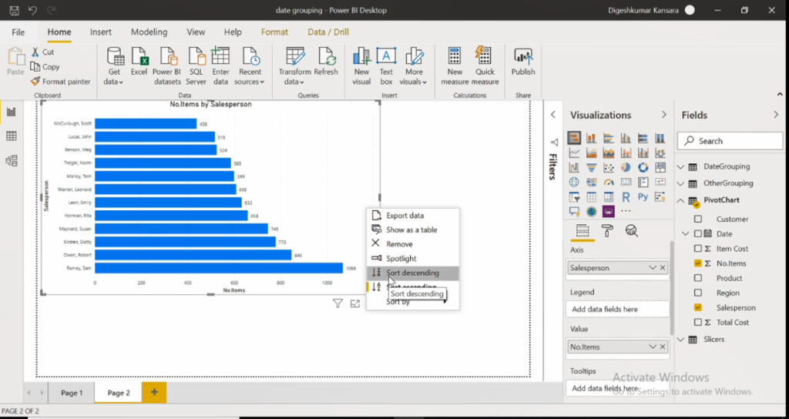
Ascending and Descending data we can also order data in ascending or descending order with them it become easy to analyze data. Sorting data is very important to analyze it.

Slide 60

Stacked Column Chart Axis: Sales Person Legend: product values: no Items

Slide 61

100% stacked bar chart

Slide 62

100% stacked Column chart

Slide 63

Other Grouping good feature of power bi is that we can do any mathematical function like sum ,subtraction etc. In transform data got to conditional column menu and we can see following screen.

Slide 64

ADD Column for example we can add NE and SE column as follows.

Slide 65


Slide 66

STEP 4: New Features in Power BI Pivot Tables that weren’t there in Excel Field formatting in units, thousands, millions etc Select the Matrix visual and go to the Format Tab

Slide 67

Scroll down to Field Formatting

Slide 68

And set the Display units as per your need, in this example I have selected thousands and thus the output is displayed as follows in the next screenshot.

Slide 69


Slide 70
Covid -19 Analysis using Power BI

Slide 71
Data source
World and USA:https://github.com/CSSEGISandData/COVID-19/tree/master/csse_covid_19_data/csse_covid_19_time_series (John Hopkins University)
India:https://en.wikipedia.org/wiki/2020_coronavirus_pandemic_in_India (India covid 19 Wikipedia)

Slide 72



Table

Slide 73


Covid 19 dashboard wORLD:

Slide 74


World with filter

Slide 75


USA:

Slide 76


USA With Filter state

Slide 77


USA county Filter

Slide 78

India

Slide 79

India With Filter state

Slide 80
Discussion
One of the interesting thing to learn from this, is the service tool designed to bring business intelligence capabilities. Power BI is great because it puts capabilities across the end to end BI stack into the hand of the end users including extraction of data , transformation of data , data modelling and visualization of data.

Slide 81
Conclusion
Hopefully this overview might have helped in understanding the creating and formatting the pivot table in Power BI.
Apart from that we also tried creating a dashboard of covid-19 and tried to visualize the count of countries like USA and India.

Slide 82
Web References
https://www.edureka.co/community/63317/how-to-create-pivot-tables-in-power-bi
https://www.goodly.co.in/create-pivot-table-in-power-bi/
https://exceleratorbi.com.au/who-needs-power-pivot-power-query-and-power-bi-anyway/

Slide 83
Question and Answer Session
The End

